Slide 1
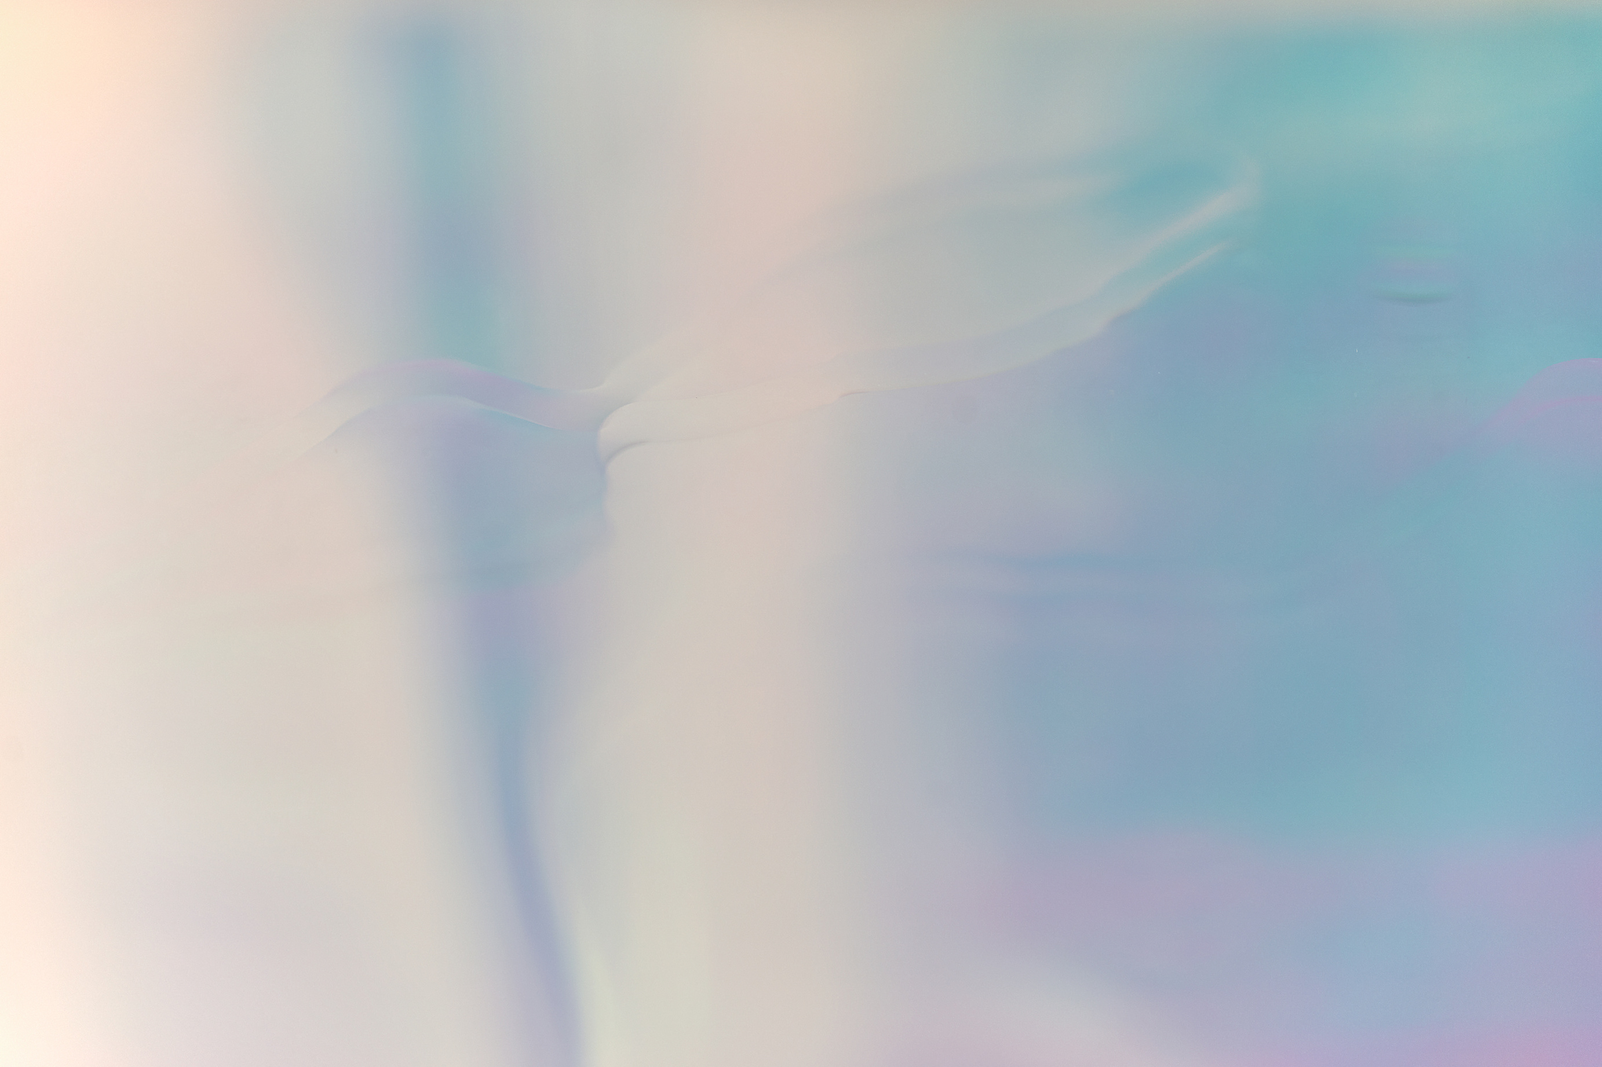
THE LIPSTICK EFFECT
Using Google Trends API
Presented by Bailey Carpenter

Slide 2
RESEARCH QUESTION
Does the search intensity for luxury cosmetics and skincare coincide with decreased wages?

Slide 3
VARIABLES
Skincare Brands:
La Prairie
La Mer
Shiseido
Augustinus Bader
Caudalie
SkinCeuticals
Sisley Paris
Lancome
Kiehl’s
Cosmetic Brands:
Chanel Beauty
Tom Ford Beauty
Dior Beauty
YSL Beauty
Charlotte Tilburry
Laura Mercier
Bureau of Labor Statistics
Wage and Salary growth over a 12 month period, presented as a percent per yearly quarter
Luxury Index:
generated variable representing the general interest for luxury brands

Slide 4
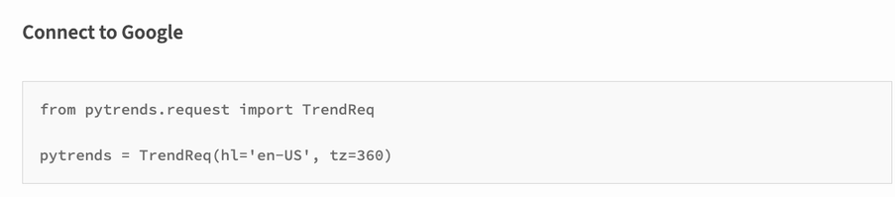
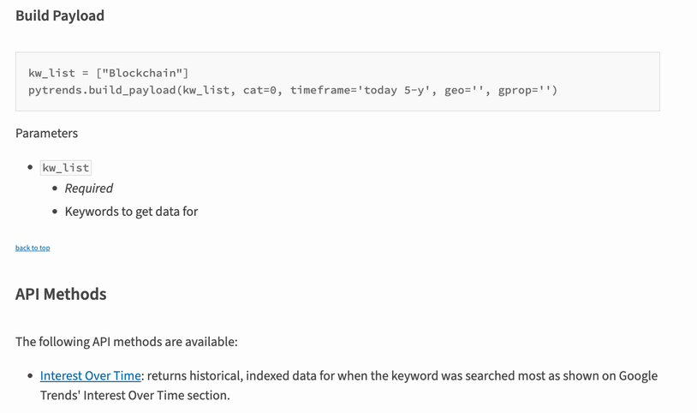
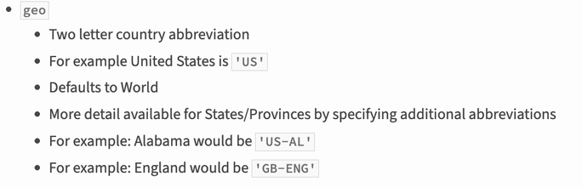
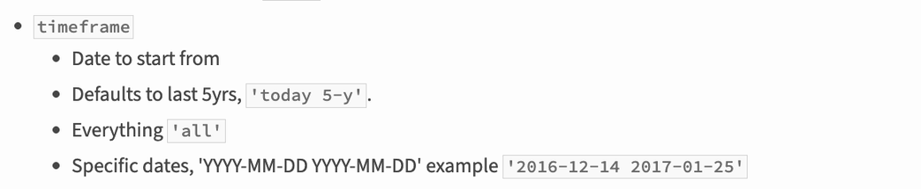
USING APIS
API Used: Pytrends
Parameters:
timeframe
geo
Main Issue:
Google does not like large scaled pull requests, so the function “time.sleep” was used to create pauses in the requests
Additionally, variables were batched into groups of 5 with a single anchor variable for normalization

Slide 5
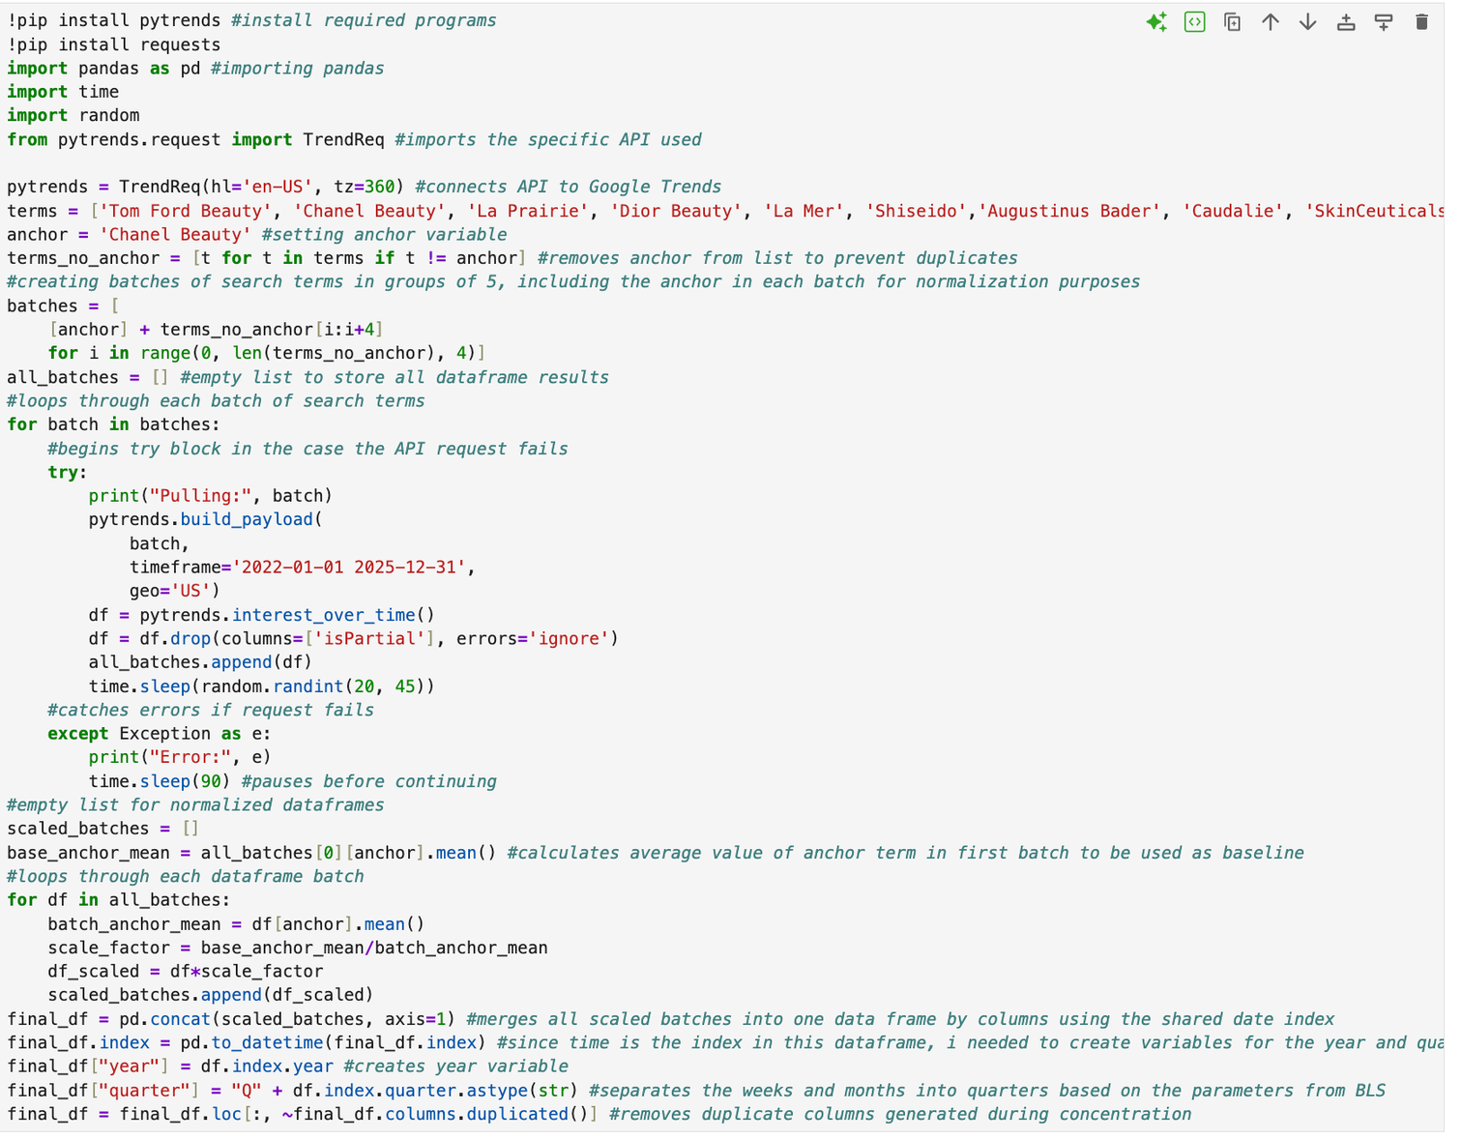

Slide 6
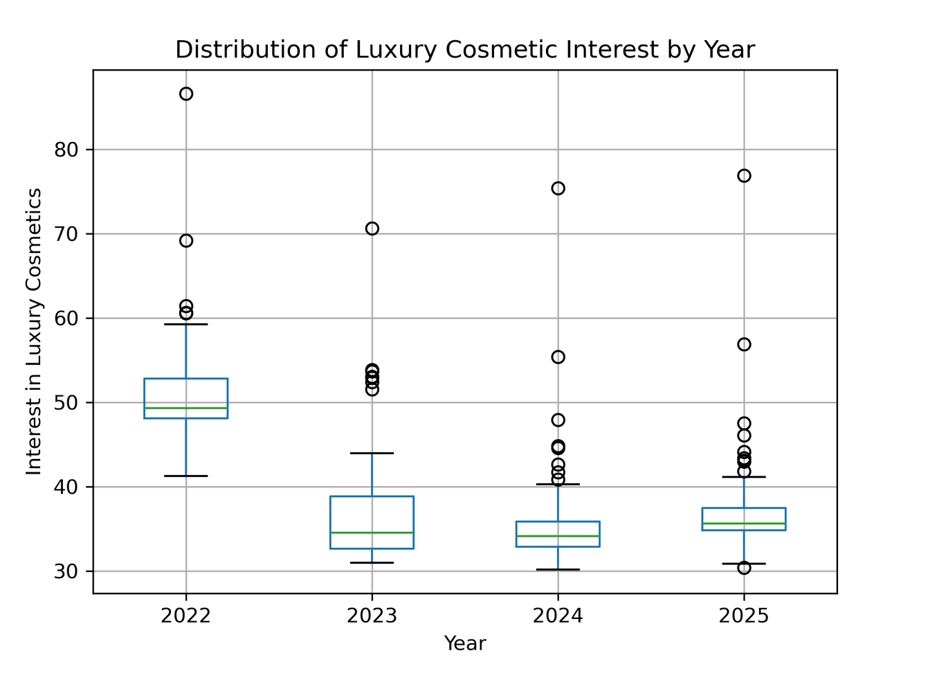
GRAPH 1

Slide 7
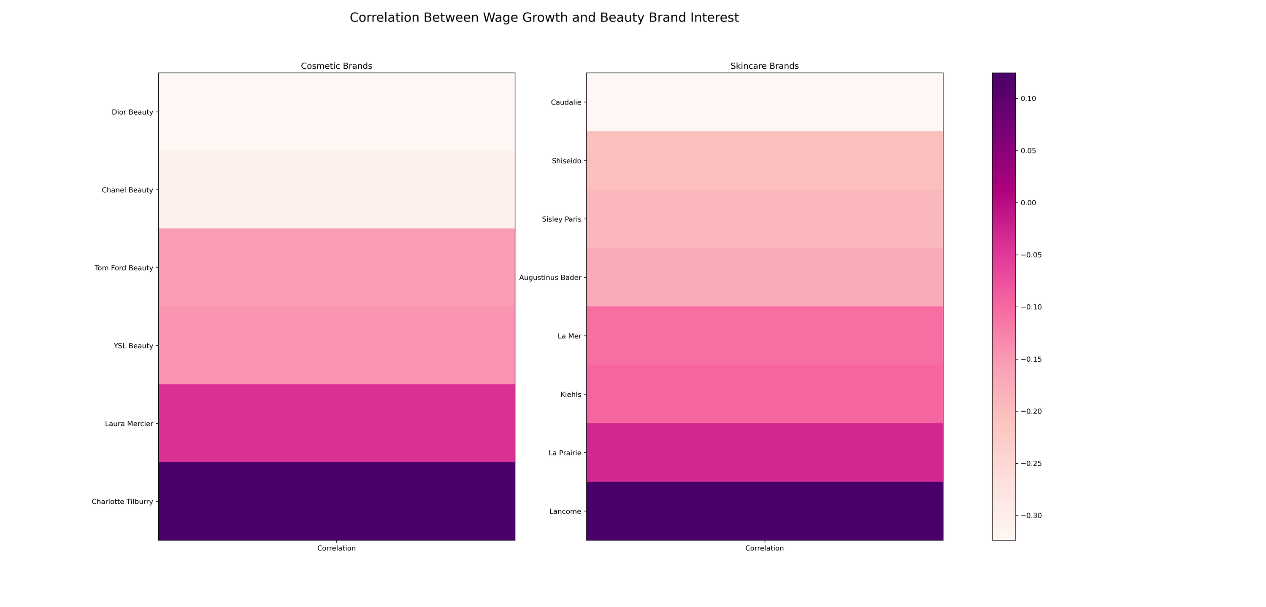
GRAPH 2

Slide 8
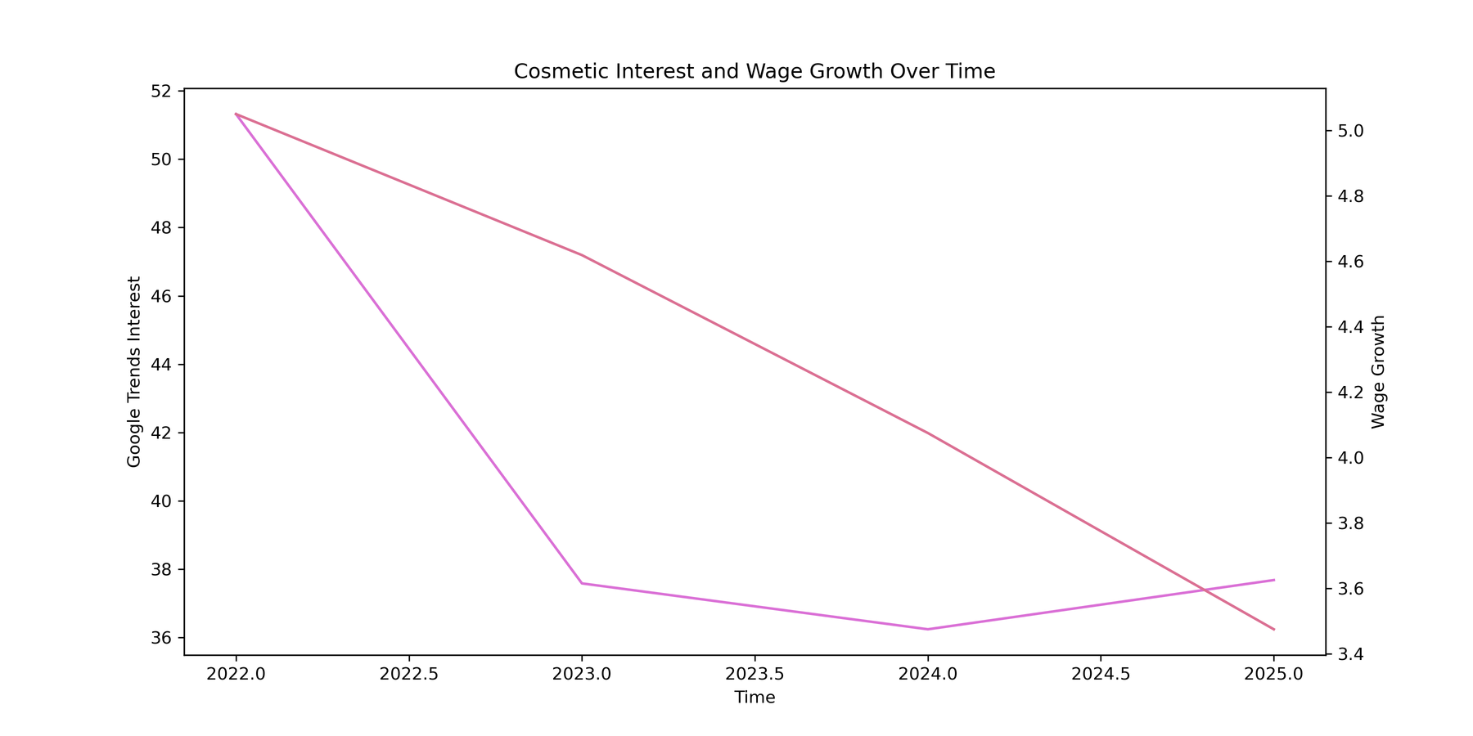
GRAPH 3

Slide 9
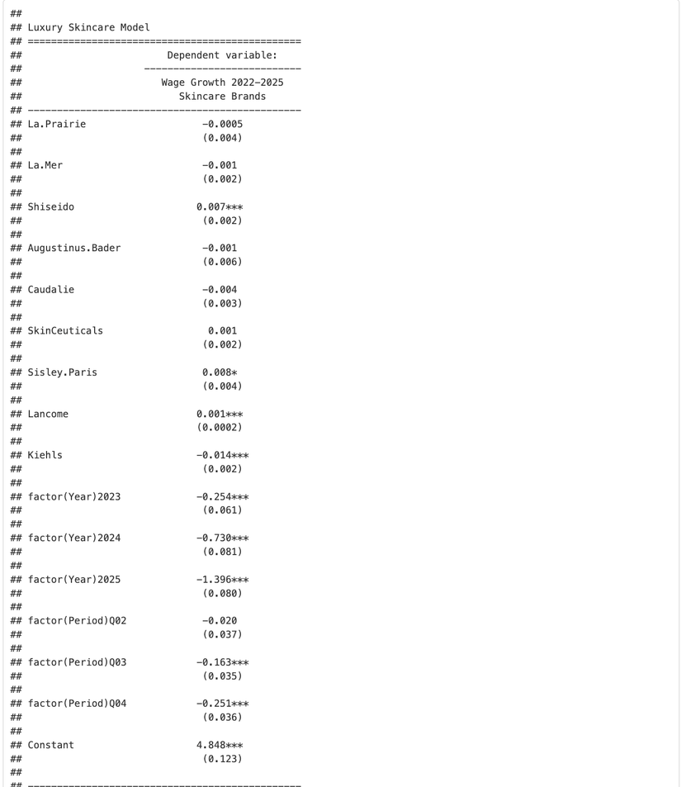
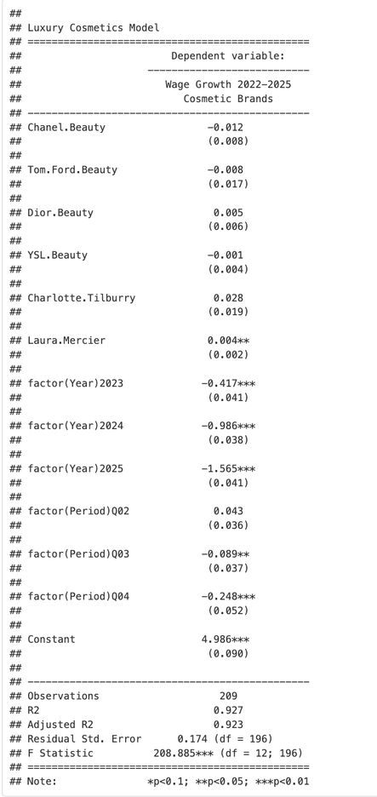
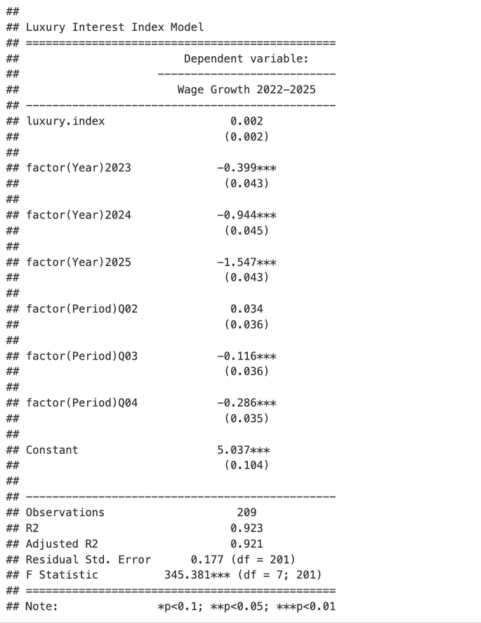
RESULTS

Slide 10
RESULTS
Luxury Index:
Coefficient: 0.02
Skincare Model:
La Prairie: -0.005
La Mer: -0.01
Shiseido: 0.07***
Augustinus Bader: -0.01
Caudalie: -0.04
SkinCeuticals: 0.01
Sisley Paris: 0.08*
Lancome: 0.001***
Kiehl’s: -0.14***
Cosmetic Brands:
Chanel Beauty: -0.12
Tom Ford Beauty: -0.08
Dior Beauty: 0.05
YSL Beauty: -0.01
Charlotte Tilburry: 0.28
Laura Mercier: 0.04**
*All coefficients were multiplied by 10 for ease in interpreting

Slide 11
CONCLUSIONS
Though some were statistically significant, the value size does not provide evidence of the lipstick effect
Lipstick effect may not be seen in search trends, rather simply in the sales for these brands
Many of these brands are sold on sites like Sephora or Ulta, meaning people looking to purchase may go to these sites first rather than direct Google searches

Slide 12
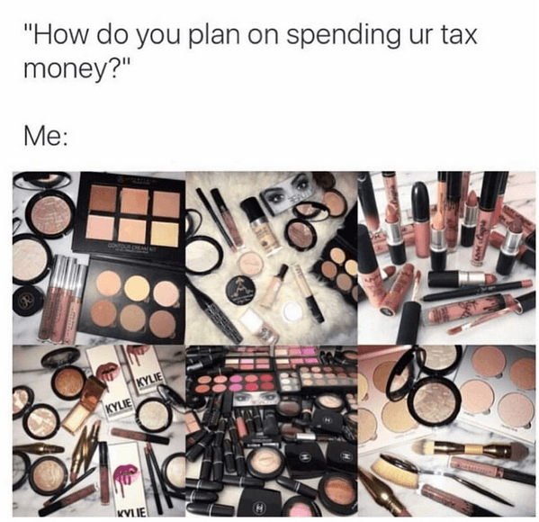
THANK
YOU

